Slide 1
Musical Exercise As physiotherapy
Presented by
Ridwan Ahmed Khan

Slide 2
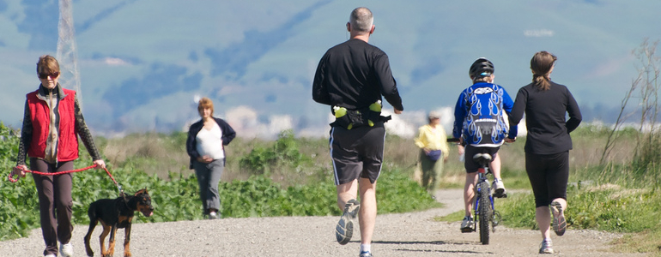
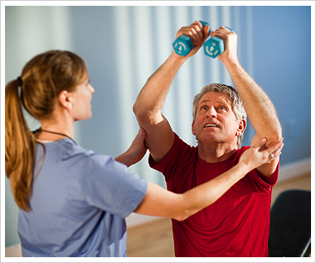
Introduction
Physical exercise is essential to maintain a good health
It is even more essential for people who need physiotherapy to keep their body active.

Slide 3
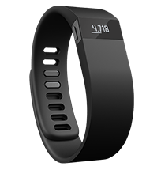
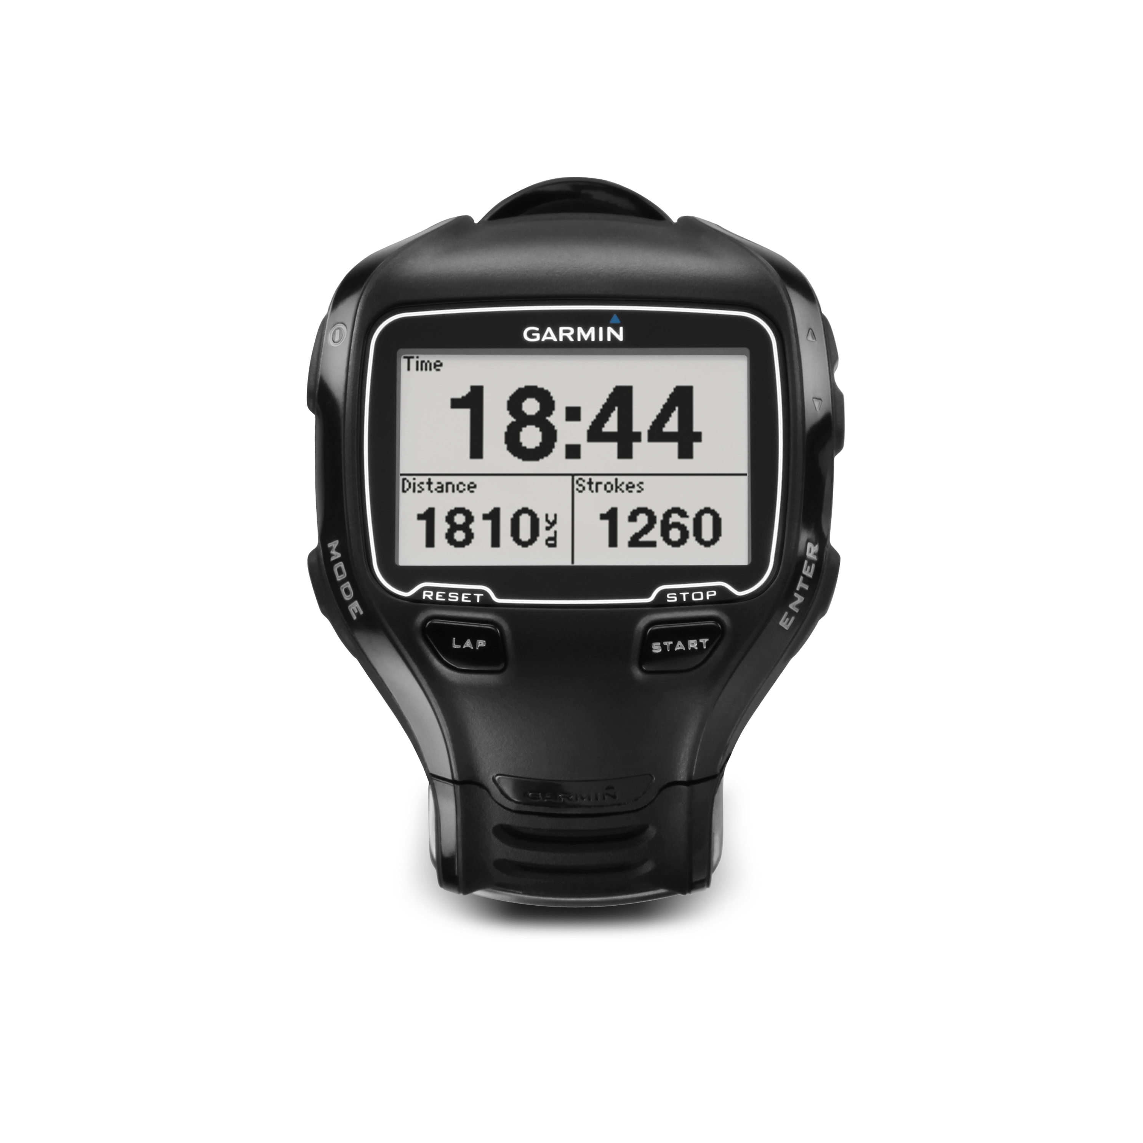
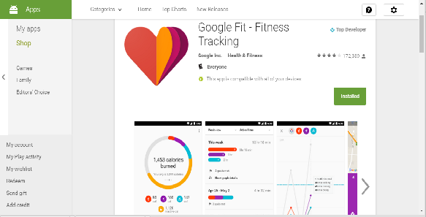
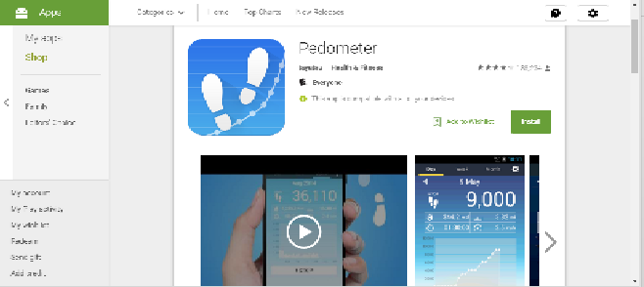
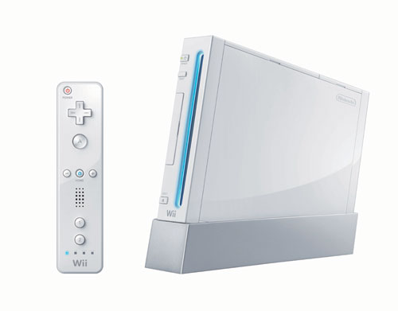
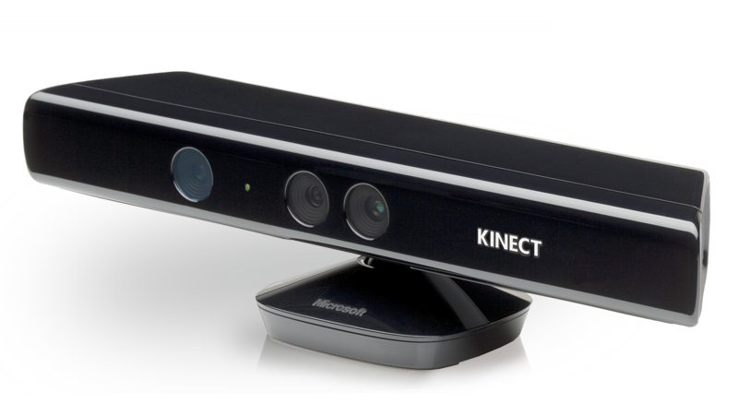
Technology for exercising
Fitbit , Garmin, Jawbone etc.
Smartphone applications
Kinect, Ninetendo Wii

Slide 4
Related Works -1
“Using the kinect to encourage older adults to exercise: A prototype” by S. Ganesan and L. Anthony

Slide 5
Related Works - 2
“A Kinect-based System for Physical Rehabilitation: Utilizing Tai Chi Exercises to Improve Movement Disorders in Patients with Balance Ability” by T.-Y. Lin, C.-H. Hsieh, and J.-D. Lee

Slide 6
Related Works - 3
“Paperdude a virtual reality cycling exergame” by J. Bolton, M. Lambert, D. Lirette, and B. Unsworth,

Slide 7
Related Works - 4
“A kinect-based system for lower limb rehabilitation in parkinson’s disease patients: A pilot study,” by G. Palacios-Navarro, I. García-Magariño, and P. Ramos-Lorente,
“Kinectwheels: Wheelchair-accessible motion-based game interaction,” by K. M. Gerling, M. R. Kalyn, and R. L. Mandryk
“Bringing mobile guides and fitness activities together: A solution based on an embodied virtual trainer,” by F. Buttussi, L. Chittaro, and D. Nadalutti
«Motivating people with chronic pain to do physical activity: Opportunities for technology design» by A. Singh, A. Klapper, J. Jia, A. Fidalgo, A. Tajadura-Jiménez, N. Kanakam, N. Bianchi-Berthouze, and A. Williams.
“Gaming for upper extremities rehabilitation” by M.-C. Huang, E. Chen, W. Xu, and M. Sarrafzadeh
“Virtual rehabilitation system for people with parkinson’s disease,” by S. Albiol-Pérez, J. Lozano-Quilis, H. Gil-Gómez, J. Gil-Gómez, and R. Llorens.

Slide 8
Proposed system

Slide 9
Kinect

Slide 10
Why the proposed system is different?
Bi modal feedback system – auditory and visual
Music for motivation
Social network integration
Accomplishment badges
List of exercise module as training program
Peer pressure
Real time feedback and recording
At home without anyone’s help

Slide 11
Future Plan
We have to develop the system as a MVP (minimum viable product)
Pilot study with the product
Collect user feedback
Consult with physiotherapist for training program design
Facilitating unified recognition system for different kinds of disabilities training program.
Music choice
Effects of affect

Slide 12
Thanks !!!
ridwank@mtu.edu

Slide 13
References
All the images/videos are taken from images.google.com or from the respective reference paper.
All the references mentioned in my topic paper which could be found in the below links:
http://www.csl.mtu.edu/classes/cs4760/www/projects/s16/grad11/www/downloads/Musical%20Exercise%20as%20Physiotherapy.pdf

